Slide 1
FINAL YEAR PROJECT – CS619
Website for VU Sports Society
A Flask-Based Web Application for Managing Sports Events, Teams & Participants
Group ID:
F25PROJECTF3ABD
Semester:
Fall 2025
Student (VU ID):
BC220416508
Course:
CS619 – Software Project
Supervisor:
Mr. Abdur Rafay
Virtual University of Pakistan | Department of Computer Sciences

Slide 2
Presentation Agenda
VU Sports Society | CS619
Topics covered in this presentation
Introduction & Project Overview
01
Sequence Diagrams
07
Problem Statement & Objectives
02
Class Diagram
08
Process Model (Agile)
03
Entity-Relationship Diagram
09
Use Case Diagram
04
Database Design
10
Business Rules Catalog
05
User Interfaces
11
Architectural Design
06
Tools & Technology Stack
12
Group: F25PROJECTF3ABD | BC220416508 | Supervisor: Mr. Abdur Rafay | CS619 Fall 2025
2

Slide 3
Group Members Introduction
VU Sports Society | CS619
Project team and supervisor details
Project Team
1
BC220416508
Role: Full-Stack Developer
Skills: Flask, React.js, MongoDB, Flask-SocketIO, JWT Auth, Tailwind CSS, Git, API Design, Testing
Project Supervisor
Mr. Abdur Rafay | abdur.rafay@vu.edu.pk | Software Projects & Research Section, Dept. of CS, VU
Domain: Web Application
Tech: Flask + React.js + MongoDB
Group: F25PROJECTF3ABD | BC220416508 | Supervisor: Mr. Abdur Rafay | CS619 Fall 2025
3

Slide 4
Introduction – Project Overview
VU Sports Society | CS619
The problem, proposed solution, and impact
Background & Problem
Proposed Solution
Manual sports management at VU leads to:
• Inefficiencies in event registration
• Poor coach-participant communication
• No centralized performance tracking
• Scaling issues with growing demand
Flask-based web application that:
• Automates event & team management
• Role-based dashboards (3 user types)
• Real-time chat & push notifications
• Performance stats & leaderboards
Platform Type
Target Users
Key Metrics
Full-Stack Web App
(SPA + REST API)
Participants (Students/Staff)
Coaches / Team Leaders
Administrators
3 User Roles
19 Test Cases Passed
12+ Core Features
Group: F25PROJECTF3ABD | BC220416508 | Supervisor: Mr. Abdur Rafay | CS619 Fall 2025
4

Slide 5
Introduction – User Roles & Key Features
VU Sports Society | CS619
Three distinct user types with tailored capabilities
Participants
(Students/Staff)
Coaches /
Team Leaders
Administrators
Register (max 2 sports)
Register (Admin approval required)
Full user management (add/block/delete)
Login (Coach approval required)
Create & manage sports teams
Approve teams & event registrations
View & register for events
Assign roles & coordinate practices
Schedule events & manage logistics
Join or create sports teams
Review participant profiles
Send notifications to all users
Track performance & leaderboards
Organize events & matches
Manage sports categories
Real-time chat with coaches
Monitor performance & feedback
View stats & generate reports
Group: F25PROJECTF3ABD | BC220416508 | Supervisor: Mr. Abdur Rafay | CS619 Fall 2025
5

Slide 6
Development Process Model
VU Sports Society | CS619
Agile – Iterative & Incremental Methodology (10 Sprints × 2 Weeks)
1
2
3
4
Phase 1: Analysis
Phase 2: Design
Phase 3: Development
Phase 4: Testing
Sprints 1-2
Sprints 3-4
Sprints 5-8
Sprints 9-10
Requirements Gathering
SRS Document
Use Cases & Scenarios
Methodology Selection
Architecture Diagram
ERD & Class Diagram
Sequence Diagrams
UI Wireframes
Flask Backend + APIs
React.js Frontend
MongoDB Database
Real-time Chat Module
Unit & Integration Tests
19 Test Cases
UAT with Supervisor
Final Deployment
Each sprint = 2 weeks | Supervisor reviews conducted after each phase
Group: F25PROJECTF3ABD | BC220416508 | Supervisor: Mr. Abdur Rafay | CS619 Fall 2025
6

Slide 7
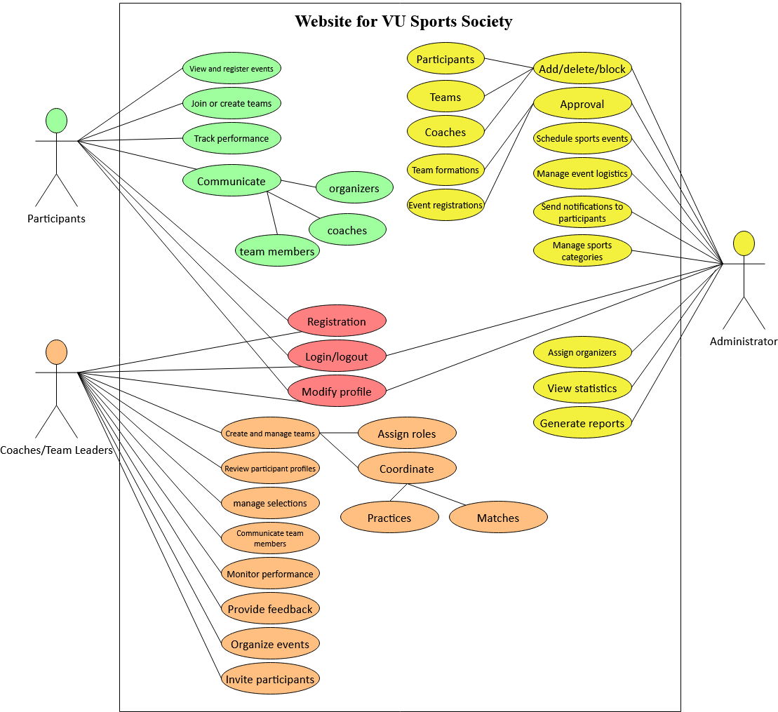
Use Case Diagram
VU Sports Society | CS619
System actors and their core interactions
Register
Register (Admin appvl)
Login / Logout
Participant
Coach / TL
Administrator
Group: F25PROJECTF3ABD | BC220416508 | Supervisor: Mr. Abdur Rafay | CS619 Fall 2025
7

Slide 8
Business Rules Catalog
VU Sports Society | CS619
Core functional requirements of the system
BR-01
Participants can register for a maximum of 2 sports.
BR-07
Admin must approve event registrations before confirmation.
BR-02
Participant login requires prior Coach approval after registration.
BR-08
Passwords must be hashed with bcrypt before storage.
BR-03
Coach login requires Admin approval after registration.
BR-09
JWT tokens must be validated for all protected API routes.
BR-04
One coach is assigned per sport category.
BR-10
Real-time chat is delivered via WebSocket (Flask-SocketIO).
BR-05
Coaches must approve participants before they can join the team.
BR-11
Performance statistics are visible to participants and coaches.
BR-06
Admin must approve all team formations before activation.
BR-12
Administrators can block, delete, or modify any user account.
Group: F25PROJECTF3ABD | BC220416508 | Supervisor: Mr. Abdur Rafay | CS619 Fall 2025
8

Slide 9
Architectural Design
VU Sports Society | CS619
MVC Pattern – Three-Tier Client-Server Architecture
PRESENTATION
(Frontend)
APPLICATION
(Flask Backend)
DATA LAYER
(MongoDB)
JWT auth enforced at middleware layer | WebSocket via Flask-SocketIO for real-time features
Group: F25PROJECTF3ABD | BC220416508 | Supervisor: Mr. Abdur Rafay | CS619 Fall 2025
9

Slide 10
Team Structure & Project Schedule
VU Sports Society | CS619
Roles and Gantt-style development timeline
Team Structure
Project Schedule Overview
1
BC220416508
Analysis (Sprints 1-2)
4W
Role: Full Stack Developer
Flask, React.js, MongoDB, SocketIO, JWT, Testing
Design (Sprints 3-4)
4W
2
Mr. Abdur Rafay
Development (Sprints 5-8)
8W
Role: Project Supervisor
Guidance, Review, Requirements Validation, Approval
Testing (Sprints 9-10)
4W
Total Duration: 20 Weeks (10 Sprints x 2 Weeks each)
Group: F25PROJECTF3ABD | BC220416508 | Supervisor: Mr. Abdur Rafay | CS619 Fall 2025
10

Slide 11
Sequence Diagram – Participant Registration & Approval
VU Sports Society | CS619
Interaction between Participant, System, Coach, and Database
Participant
Flask API
Coach
MongoDB
1. Submit Registration Form
2. Validate & Save User (status: pending)
3. Return: User Created
4. Notify Coach of New Registration
5. Coach Reviews & Approves Profile
6. Update User Status: Approved
7. Send Approval Notification to Participant
After step 7, the Participant can log in to the system with full access.
Group: F25PROJECTF3ABD | BC220416508 | Supervisor: Mr. Abdur Rafay | CS619 Fall 2025
11

Slide 12
Sequence Diagram – Event Registration Flow
VU Sports Society | CS619
How a Participant registers for a Sports Event
Participant
React UI
Flask API
Admin
MongoDB
1. Browse Events Page
2. GET /api/events (approved=true)
3. Query approved events from DB
4. Return events list
5. POST /api/events/register (event_id)
6. Save EventRegistration (status: pending)
7. Notify Admin of new registration
8. Admin approves or rejects
9. Confirmation notification to Participant
Group: F25PROJECTF3ABD | BC220416508 | Supervisor: Mr. Abdur Rafay | CS619 Fall 2025
12

Slide 13
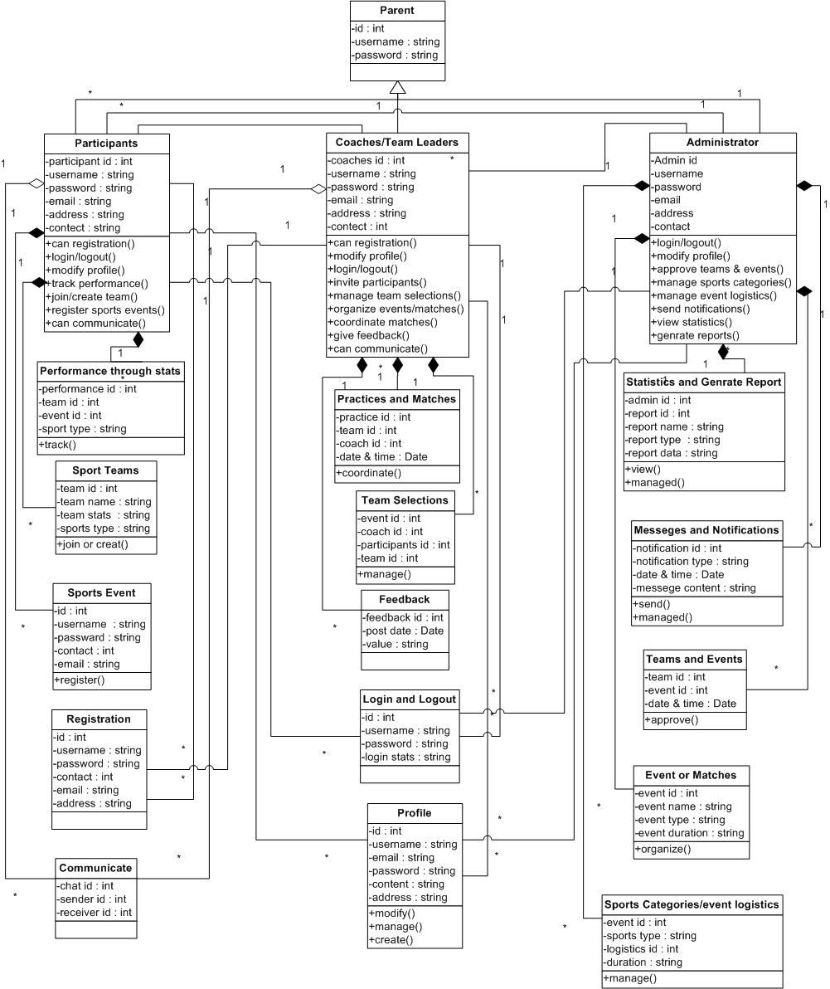
Logical Model / Class Diagram
VU Sports Society | CS619
Core application classes, attributes, and relationships
User
Profile
Group: F25PROJECTF3ABD | BC220416508 | Supervisor: Mr. Abdur Rafay | CS619 Fall 2025
13

Slide 14
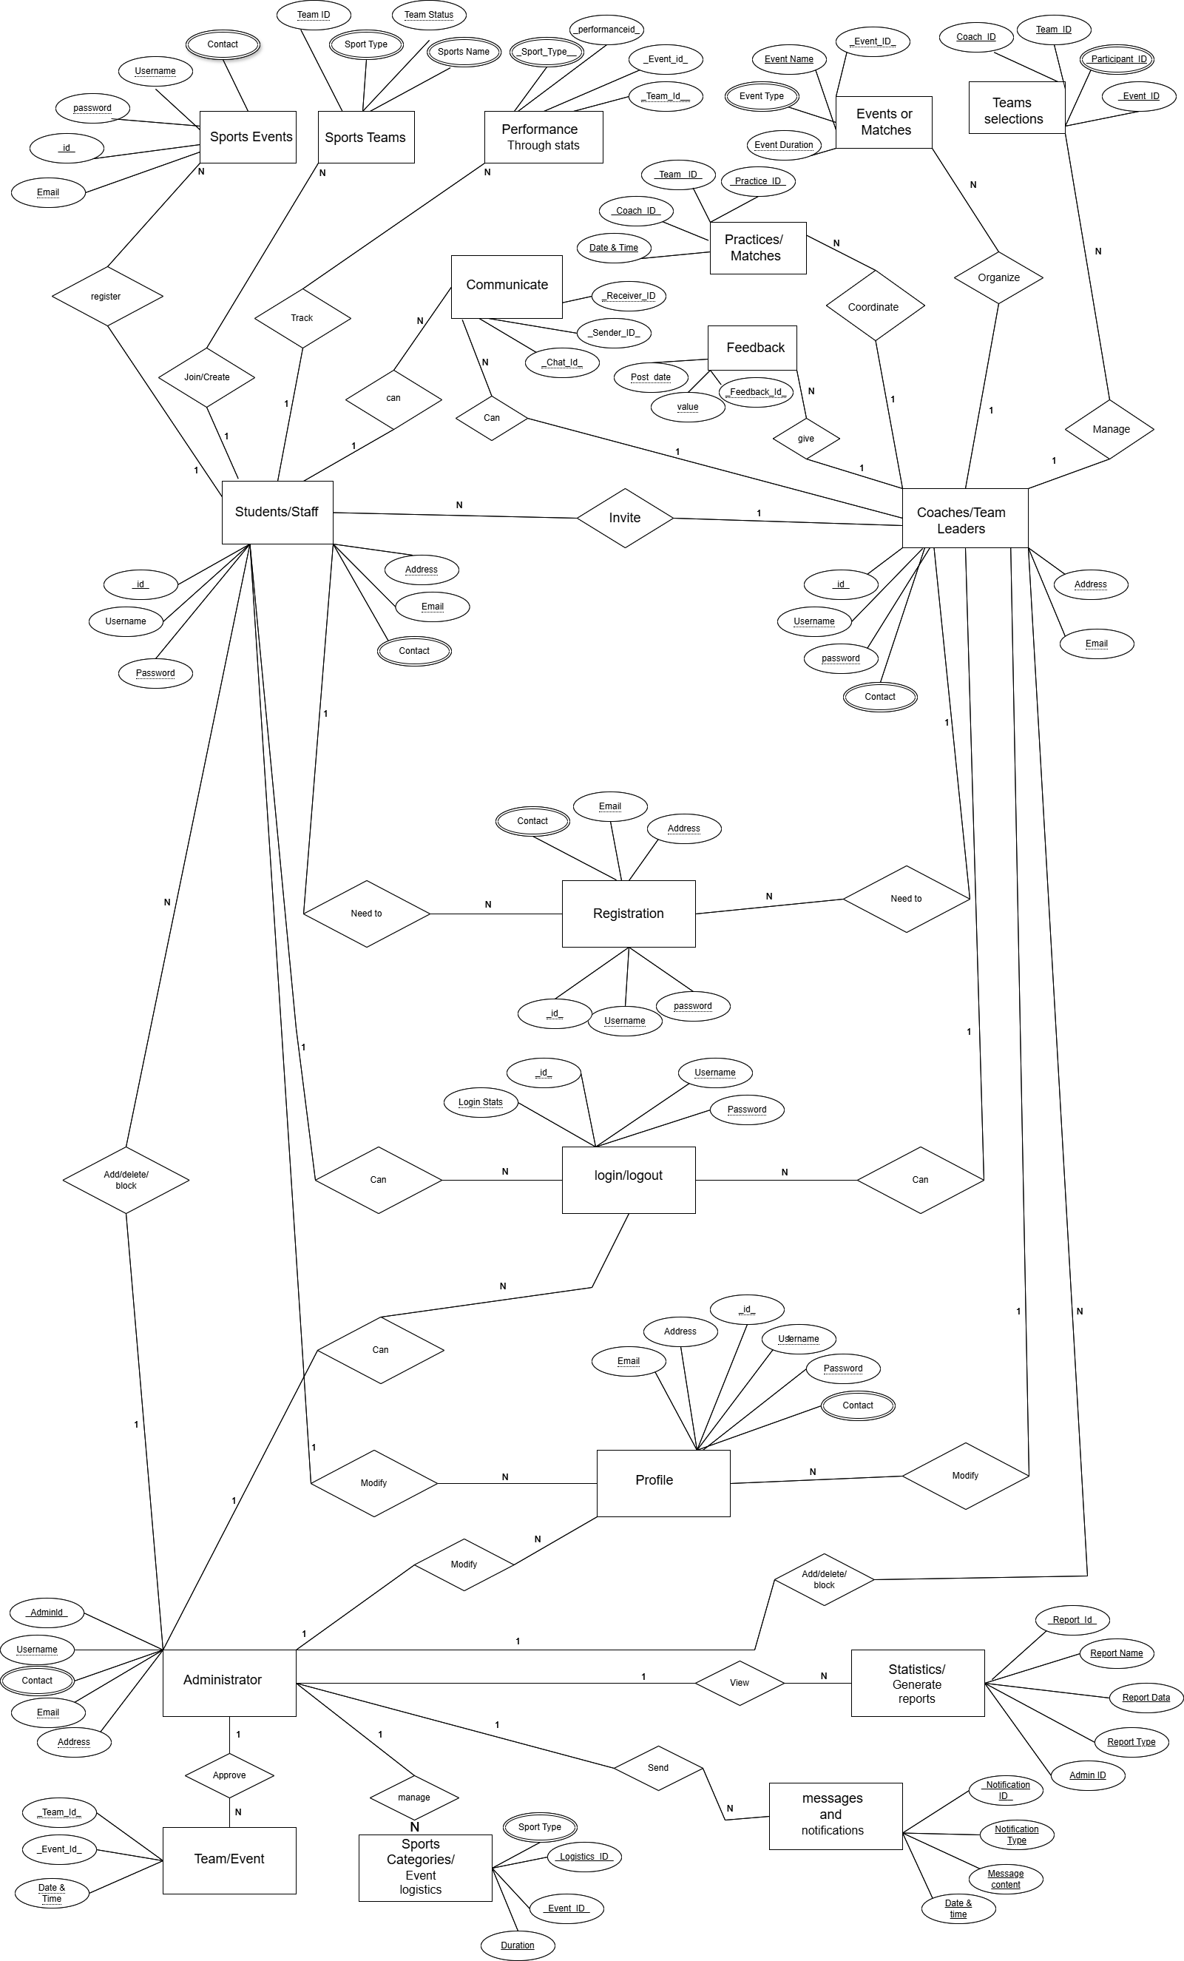
Entity-Relationship Diagram (ERD)
VU Sports Society | CS619
Database entities and their relationships
EVENT
SPORTS_CATEGORY
1 USER → N EVENT_REGISTRATIONS | 1 EVENT → N REGISTRATIONS | 1 COACH (USER) → N TEAMS | 1 SPORTS_CATEGORY → N EVENTS
Group: F25PROJECTF3ABD | BC220416508 | Supervisor: Mr. Abdur Rafay | CS619 Fall 2025
14

Slide 15
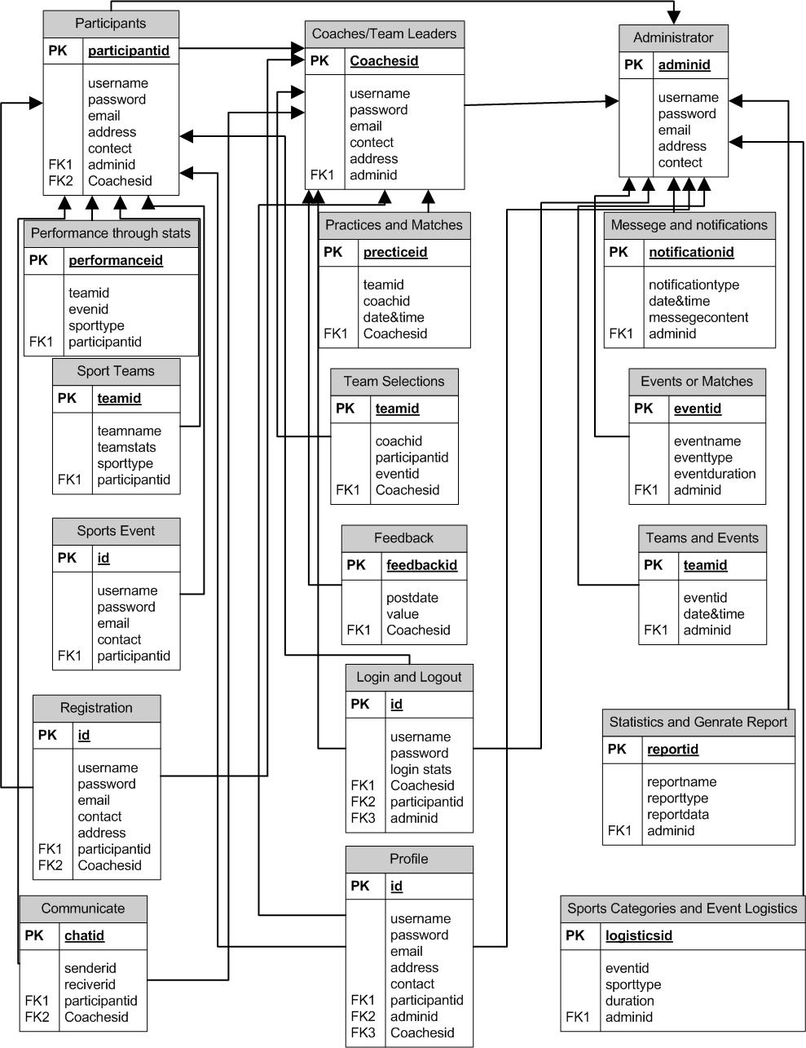
Database Design
VU Sports Society | CS619
MongoDB Collections Schema
Group: F25PROJECTF3ABD | BC220416508 | Supervisor: Mr. Abdur Rafay | CS619 Fall 2025
15

Slide 16
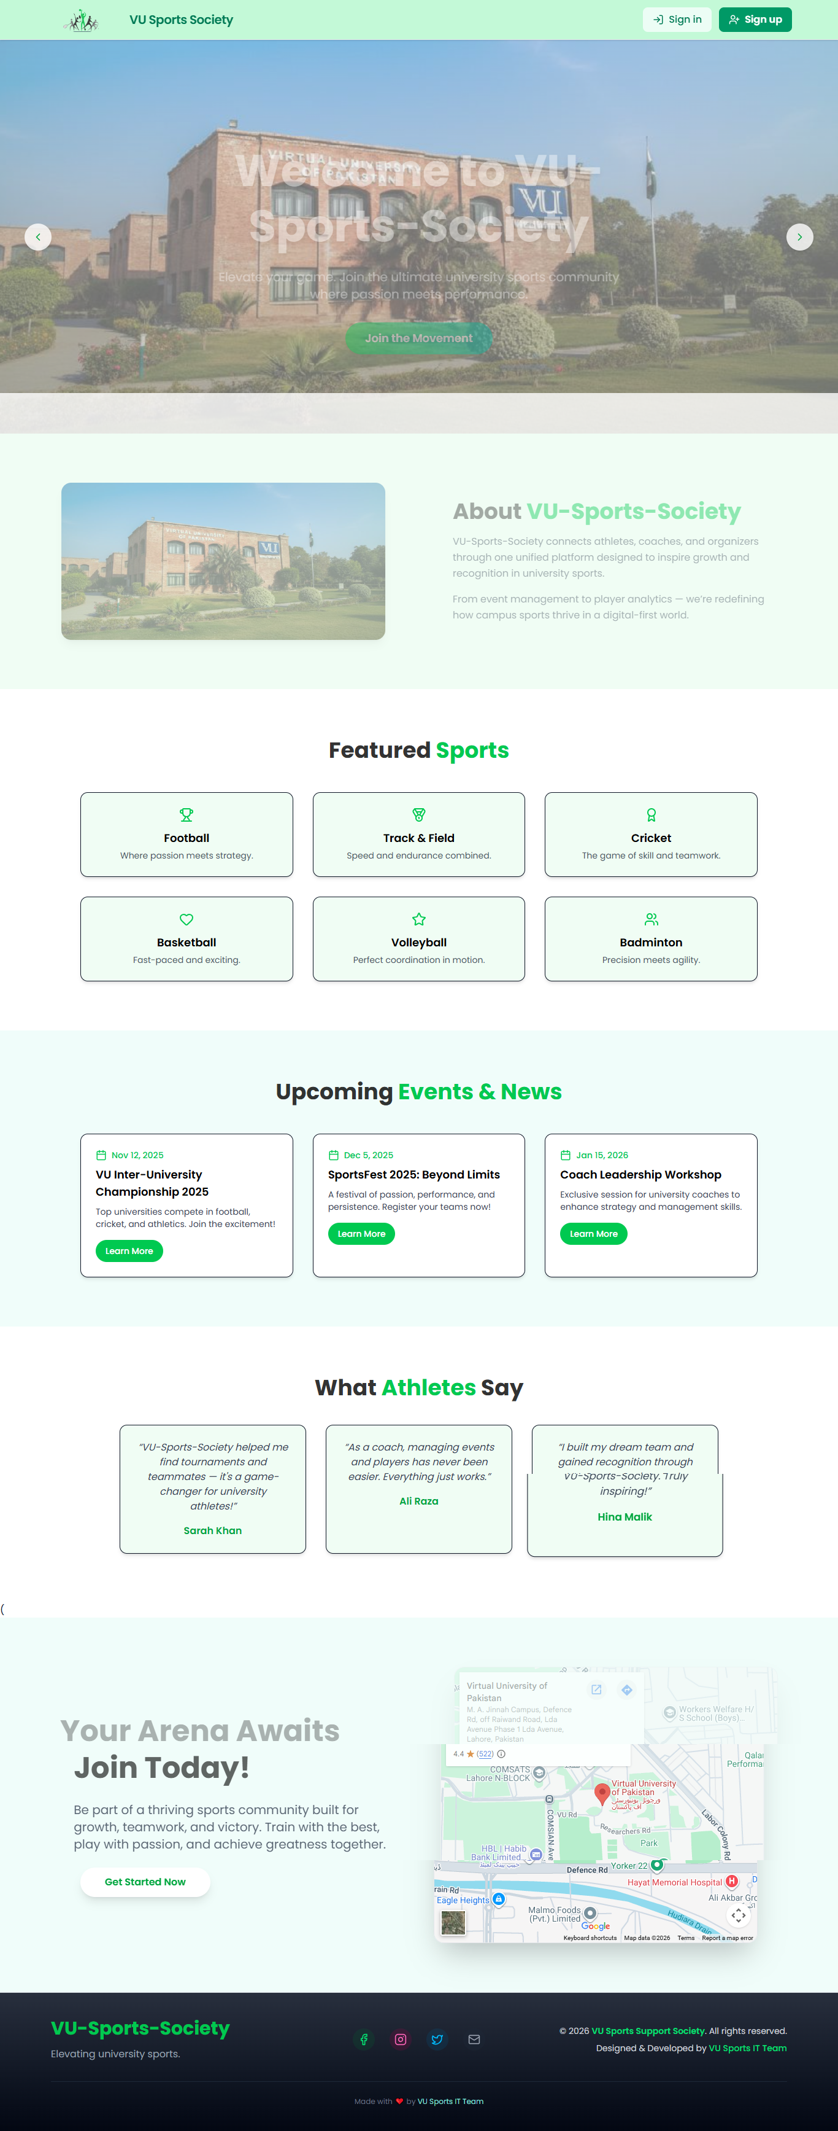
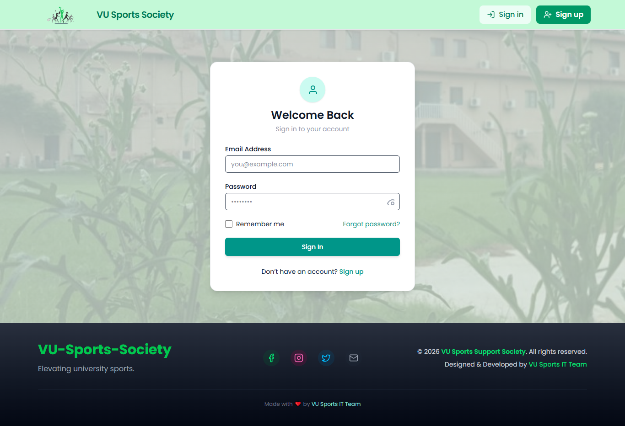
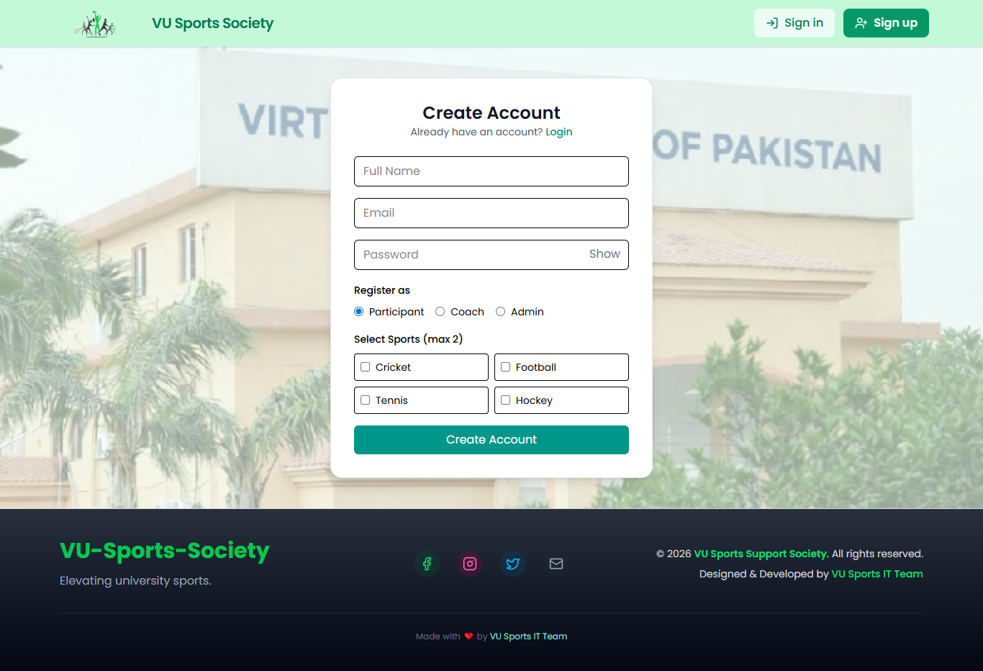
User Interfaces – Application Screens
VU Sports Society | CS619
Key pages for each user role
Group: F25PROJECTF3ABD | BC220416508 | Supervisor: Mr. Abdur Rafay | CS619 Fall 2025
16

Slide 17
Tools & Technology Stack
VU Sports Society | CS619
Technologies used during development of this project
Python Flask
React.js (Vite)
MongoDB
Flask-SocketIO
JWT + bcrypt
Backend Framework
Frontend Framework
Production Database
Real-time Comms
Security
Lightweight WSGI framework for REST APIs
Component-based SPA with hot module replacement
NoSQL document database for flexible storage
WebSocket support for live chat & notifications
Stateless auth tokens + secure password hashing
Tailwind CSS
Git / GitHub
Axios / Fetch
Postman
npm / pip
UI Styling
Version Control
API Communication
API Testing
Package Managers
Utility-first responsive design framework
Source code management & collaboration
HTTP client for frontend-backend API calls
Endpoint testing and documentation tool
Frontend (npm) & backend (pip) dependencies
Group: F25PROJECTF3ABD | BC220416508 | Supervisor: Mr. Abdur Rafay | CS619 Fall 2025
17

Slide 18
Thank You!
Questions & Discussion
Project Summary
Fully functional Flask + React.js three-role web application
Real-time chat and push notifications via Flask-SocketIO
Complete approval workflows: Participant → Coach → Admin
Performance stats, leaderboards, and sports equipment shop
All 19 functional test cases passed successfully
F25PROJECTF3ABD | BC220416508 | Supervisor: Mr. Abdur Rafay | CS619 – Fall 2025

